Slide 1
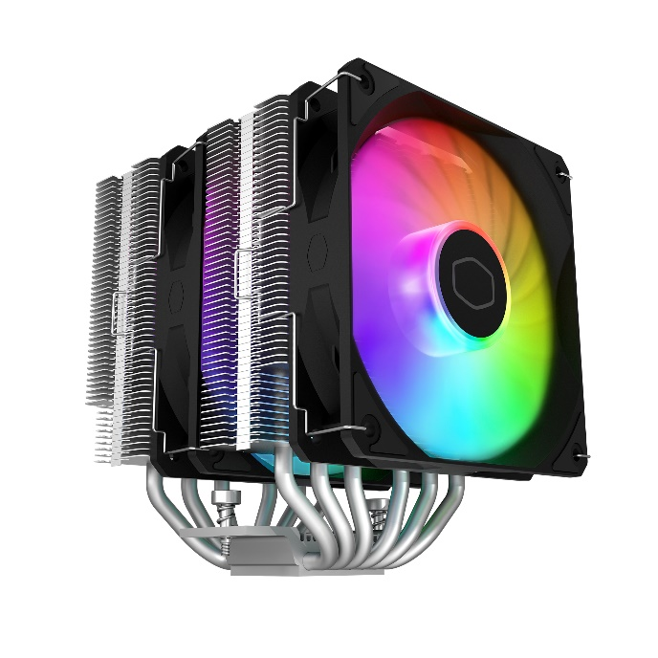
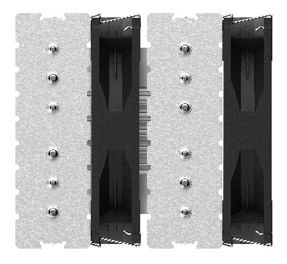
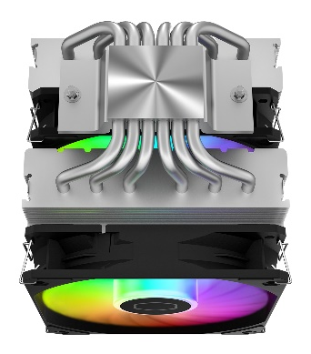
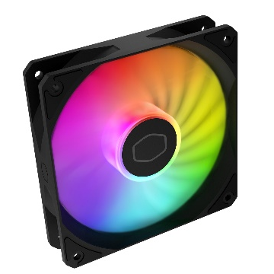
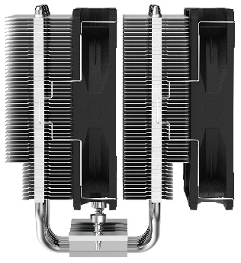
Cooler Master is advancing the Hyper Series legacy with the debut of the 6 heat pipe Hyper air cooler – the Hyper 620S. With the dual tower dual fan design, the 6 heat pipe array dissipates heat impressively to handle the newest CPUs in the market. The new fans display stunning color and lighting with easy clip to install. The cooler height is set to 154.9mm for a wide range of fitment for the majority of chassis without compromising cooling capabilities. The ARGB Auto Detection provides default ARGB spectrum lighting upon power up, or full ARGB customization through the motherboard header. We have expanded the Hyper line with an all new powerful introduction worthy of its name – Hyper 620S
HYPER 620S
Dual Dual Tower Heat Sink
6 Heat Pipes Design
Dual tower heat sink delivers twice the surface area for superior cooling
Complete CPU coverage nickel-plated base with 6 uniform heat pipes transfers heat evenly and quickly
ARGB Auto Detection
Broad Case Fitment
Intuitive LED detection automatically provides default ARGB spectrum lighting or full ARGB customization via 3-pin header connection
Low profile heat pipes optimized at 154.9mm height accommodates most RAM and case requirements

Slide 2


ARGB Auto Detection - Intuitive LED detection automatically provides default ARGB spectrum lighting or full ARGB customization via 3-pin header connection.
Broad Case Fitment - Low profile heat pipes optimized at 154.9mm height accommodates most RAM and case requirements.
Dual Tower Heat Sink - Dual tower heat sink and dual fans deliver twice the surface area for superior cooling.
6 Heat Pipes Design - Complete CPU coverage nickel-plated base with 6 uniform heat pipes transfers heat evenly and quickly.
Product NaRR-D6NA-17PA-R1 me | Hyper 620S
Product Number | RR-D6NA-17PA-R1
Exterior Color | Black/Silver
CPU Socket | Intel® LGA 1700 / 1200 / 1151 / 1150 / 1155 / 1156 socket
 | AMD® AM5 / AM4 socket
Dimensions (Lx W x H) | 125 x 137 x 154.9 mm
Heat Sink Material | 6 Heat Pipes/ Aluminum Fins
Fan | Dimensions (L x W x H) | 120 x 120 x 25mm
 | Profile | Addressable RGB
 | Quantity (pcs) | 2 PCS
 | Speed | 650~1750 RPM ± 10%
 | Airflow (Max) | 71.93 CFM
 | Pressure (Max) | 1.86 mmH2O
 | MTTF | >160,000 hours
 | Noise Level (Max) | 27.2 dB(A)
 | Bearing | Rifle
 | Power Connector | 4-Pin PWM
 | Rated Voltage | 12 VDC
 | Rated Current | 0.26 A
 | Safety Current | 0.37 A
 | Power Consumption | 3.12 W
Warranty | 2 years
EAN code | 4719512137956
UPC code | 884102110276
Net weight | 1.11 kg
Gross weight | 1.57 kg
Package dimension (L x W X H) | 17.3 x 15.9 x 20.3 cm
Carton dimension (L x W x H) | 48.7 x 36.2 x 23.8 cm
Units/CTN | 6
Cont. | W/ Pallet | Carton/ Pallet | W/O Pallet
20’ | 2880 | 48 | N/A
40’ | 5760 | 48 | N/A
40 HQ | 6480 | 54 | N/A

